Slide 1
Why Pandas?
One of the most popular library that data scientists use
Labeled axes to avoid misalignment of data
Data[:, 2] represents weight or weight2?
When merge two tables, some rows may be different
Missing values or special values may need to be removed or replaced
 | height | Weight | Weight2 | age | Gender
Amy | 160 | 125 | 126 | 32 | 2
Bob | 170 | 167 | 155 | -1 | 1
Chris | 168 | 143 | 150 | 28 | 1
David | 190 | 182 | NA | 42 | 1
Ella | 175 | 133 | 138 | 23 | 2
Frank | 172 | 150 | 148 | 45 | 1
 | salary | Credit score
Alice | 50000 | 700
Bob | NA | 670
Chris | 60000 | NA
David | -99999 | 750
Ella | 70000 | 685
Tom | 45000 | 660
Notes:
Created by Wes McKinney in 2008, now maintained by Jeff Reback and many others.
Author of one of the textbooks: Python for Data Analysis
Powerful and productive Python data analysis and Management Library
Panel Data System
Its an open source product.

Slide 2
Why Pandas?
Python Library to provide data analysis features similar to: R, MATLAB, SAS
Built on top of NumPy
Rich data structures and functions to make working with data structure fast, easy and expressive.
Key components provided by Pandas:
Series
DataFrame
from pandas import Series, DataFrame
import pandas as pd

Slide 3
Series
One dimensional array-like object
It contains array of data (of any NumPy data type) with associated indexes. (Indexes can be strings or integers or other data types.)
By default , the series will get indexing from 0 to N where N = size -1
In [666]: obj = Series([4, 7, -5, 3])
In [667]: obj
Out[667]:
0 4
1 7
2 -5
3 3
dtype: int64
In [668]: obj.values
Out[668]: array([ 4, 7, -5, 3], dtype=int64)
In [669]: obj.index
Out[669]: RangeIndex(start=0, stop=4, step=1)

Slide 4
Series – referencing elements
In [818]: obj2.a
Out[818]: -5
In [670]: obj2 = Series([4, 7, -5, 3], index=['d', 'b', 'a', 'c'])
In [671]: obj2
Out[671]:
d 4
b 7
a -5
c 3
dtype: int64
In [674]: obj2['a']
Out[674]: -5
In [675]: obj2['d']=10
In [677]: obj2[['d', 'c', 'a']]
Out[677]:
d 10
c 3
a -5
dtype: int64
In [672]: obj2.index
Out[672]: Index(['d', 'b', 'a', 'c'], dtype='object')
In [673]: obj2.values
Out[673]: array([ 4, 7, -5, 3], dtype=int64)
In [692]: obj2[:2]
Out[692]:
d 10
b 7
dtype: int64

Slide 5
Series – array/dict operations
numpy array operations can also be applied, which will preserve the index-value link
Can be thought of as a dict. Can be constructed from a dict directly.
In [699]: obj2**2
Out[699]:
d 100
b 49
a 25
c 9
dtype: int64
In [694]: obj2[obj2>0]
Out[694]:
d 10
b 7
c 3
dtype: int64
In [702]: obj3 = Series({'a': 10, 'b': 5, 'c': 30})
In [703]: obj3
Out[703]:
a 10
b 5
c 30
dtype: int64
In [700]: 'b' in obj2
Out[700]: True

Slide 6
Series – null values
In [708]: pd.isnull(obj4)
Out[708]:
Texas False
Ohio False
Oregon False
Iowa True
dtype: bool
In [704]: sdata = {'Texas': 10, 'Ohio': 20, 'Oregon': 15, 'Utah': 18}
In [705]: states = ['Texas', 'Ohio', 'Oregon', 'Iowa']
In [706]: obj4 = Series(sdata, index=states)
In [707]: obj4
Out[707]:
Texas 10.0
Ohio 20.0
Oregon 15.0
Iowa NaN
dtype: float64
In [709]: pd.notnull(obj4)
Out[709]:
Texas True
Ohio True
Oregon True
Iowa False
dtype: bool
Missing value
In [717]: obj4[obj4.notnull()]
Out[717]:
Texas 10.0
Ohio 20.0
Oregon 15.0
dtype: float64

Slide 7
Series – auto alignment
In [715]: obj5 + obj4
Out[715]:
Iowa NaN
Ohio 40.0
Oregon 30.0
Texas 20.0
Utah NaN
dtype: float64
In [707]: obj4
Out[707]:
Texas 10.0
Ohio 20.0
Oregon 15.0
Iowa NaN
dtype: float64
In [714]: obj5
Out[714]:
Ohio 20
Oregon 15
Texas 10
Utah 18
dtype: int64

Slide 8
Series name and index name
In [722]: obj4.index.name = 'state'
In [723]: obj4
Out[723]:
state
Texas 10.0
Ohio 20.0
Oregon 15.0
Iowa NaN
Name: population, dtype: float64
In [720]: obj4.name = 'population'
In [721]: obj4
Out[721]:
Texas 10.0
Ohio 20.0
Oregon 15.0
Iowa NaN
Name: population, dtype: float64
In [725]: obj4.index = ['Florida', 'New York', 'Kentucky', 'Georgia']
In [726]: obj4
Out[726]:
Florida 10.0
New York 20.0
Kentucky 15.0
Georgia NaN
Name: population, dtype: float64
Index of a series can be changed to a different index.
Index object itself is immutable.
In [1014]: obj4.index[2]='California'
TypeError: Index does not support mutable operations
In [1016]: obj4.index
Out[1016]: Index(['Florida', 'New York', 'Kentucky', 'Georgia'], dtype='object')

Slide 9
DataFrame
In [727]: data = {'state': ['Ohio', 'Ohio', 'Ohio', 'Nevada', 'Nevada'],
...: 'year': [2000, 2001, 2002, 2001, 2002],
...: 'pop': [1.5, 1.7, 3.6, 2.4, 2.9]}
In [728]: frame = DataFrame(data)
In [729]: frame
Out[729]:
pop state year
0 1.5 Ohio 2000
1 1.7 Ohio 2001
2 3.6 Ohio 2002
3 2.4 Nevada 2001
4 2.9 Nevada 2002
A DataFrame is a tabular data structure comprised of rows and columns, akin to a spreadsheet or database table.
It can be treated as an order collection of columns
Each column can be a different data type
Have both row and column indices
reordered

Slide 10
DataFrame – specifying columns and indices
In [727]: data = {'state': ['Ohio', 'Ohio', 'Ohio', 'Nevada', 'Nevada'],
...: 'year': [2000, 2001, 2002, 2001, 2002],
...: 'pop': [1.5, 1.7, 3.6, 2.4, 2.9]}
Order of columns/rows can be specified.
Columns not in data will have NaN.
In [730]: frame2 = DataFrame(data, columns=['year', 'state', 'pop', 'debt'], index=['A', 'B', 'C', 'D', 'E'])
In [731]: frame2
Out[731]:
year state pop debt
A 2000 Ohio 1.5 NaN
B 2001 Ohio 1.7 NaN
C 2002 Ohio 3.6 NaN
D 2001 Nevada 2.4 NaN
E 2002 Nevada 2.9 NaN
Same order
Initialized with NaN

Slide 11
DataFrame – from nested dict of dicts
Outer dict keys as columns and inner dict keys as row indices
In [838]: pop = {'Nevada': {2001: 2.9, 2002: 2.9}, 'Ohio': {2002: 3.6, 2001: 1.7, 2000: 1.5}}
In [840]: frame3 = DataFrame(pop)
In [841]: frame3
Out[841]:
Nevada Ohio
2000 NaN 1.5
2001 2.9 1.7
2002 2.9 3.6
Transpose
In [842]: frame3.T
Out[842]:
2000 2001 2002
Nevada NaN 2.9 2.9
Ohio 1.5 1.7 3.6
Union of inner keys (in sorted order)

Slide 12
DataFrame – index, columns, values
In [850]: frame3.index.name = 'year'; frame3.columns.name='state'
In [851]: frame3
Out[851]:
state Nevada Ohio
year
2000 NaN 1.5
2001 2.9 1.7
2002 2.9 3.6
In [847]: frame3.index
Out[847]: Int64Index([2000, 2001, 2002], dtype='int64')
In [848]: frame3.columns
Out[848]: Index(['Nevada', 'Ohio'], dtype='object')
In [849]: frame3.values
Out[849]:
array([ [ nan, 1.5],
[ 2.9, 1.7],
[ 2.9, 3.6]])
(Personal opinion) Bad design: index should be called row label, column should be called column label. Index can be label-based or position-based.

Slide 13
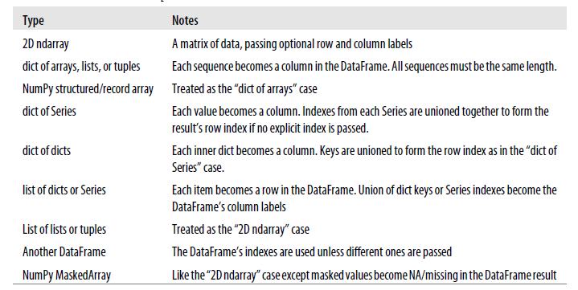
Possible data inputs to DataFrame constructor

Slide 14
Indexing, selection and filtering
Series and DataFrame can be sliced/accessed with label-based indexes, or using position-based indexes similar to Numpy Array
In [906]: S = Series(range(4), index=['zero', 'one', 'two', 'three'])
In [907]: S['two']
Out[907]: 2
In [908]: S[['zero', 'two']]
Out[908]:
zero 0
two 2
dtype: int32
In [911]: S[:2]
Out[911]:
zero 0
one 1
dtype: int32
In [917]: S[S > 1]
Out[917]:
two 2
three 3
dtype: int32
In [909]: S[2]
Out[909]: 2
In [910]: S[[0,2]]
Out[910]:
zero 0
two 2
dtype: int32
In [913]: S['zero':'two']
Out[913]:
zero 0
one 1
two 2
dtype: int32
In [995]: S[-2:]
Out[995]:
two 2
three 3
dtype: int32
Inclusive

Slide 15
DataFrame – retrieving a column
A column in a DataFrame can be retrieved as a Series by dict-like notation or as attribute
Series index and name have been kept/set appropriately
In [734]: frame['state']
Out[734]:
0 Ohio
1 Ohio
2 Ohio
3 Nevada
4 Nevada
Name: state, dtype: object
In [733]: frame.state
Out[733]:
0 Ohio
1 Ohio
2 Ohio
3 Nevada
4 Nevada
Name: state, dtype: object
In [805]: type(frame['state'])
Out[805]: pandas.core.series.Series

Slide 16
DataFrame – getting rows
loc for using indexes and iloc for using positions
In [819]: frame2.loc[['A', 'B']]
Out[819]:
year state pop debt
A 2000 Ohio 1.5 NaN
B 2001 Ohio 1.7 NaN
In [820]: type(frame2.loc[['A', 'B']])
Out[820]: pandas.core.frame.DataFrame
In [792]: frame2
Out[792]:
year state pop debt
A 2000 Ohio 1.5 NaN
B 2001 Ohio 1.7 NaN
C 2002 Ohio 3.6 NaN
D 2001 Nevada 2.4 NaN
E 2002 Nevada 2.9 NaN
In [801]: frame2.loc['A']
Out[801]:
year 2000
state Ohio
pop 1.5
debt NaN
Name: A, dtype: object
In [804]: type(frame2.loc['A'])
Out[804]: pandas.core.series.Series

Slide 17
DataFrame – modifying columns
In [829]: frame2['debt'] = 0
In [830]: frame2
Out[830]:
year state pop debt
A 2000 Ohio 1.5 0
B 2001 Ohio 1.7 0
C 2002 Ohio 3.6 0
D 2001 Nevada 2.4 0
E 2002 Nevada 2.9 0
In [831]: frame2['debt'] = range(5)
In [832]: frame2
Out[832]:
year state pop debt
A 2000 Ohio 1.5 0
B 2001 Ohio 1.7 1
C 2002 Ohio 3.6 2
D 2001 Nevada 2.4 3
E 2002 Nevada 2.9 4
In [833]: val = Series([10, 10, 10], index = ['A', 'C', 'D'])
In [834]: frame2['debt'] = val
In [835]: frame2
Out[835]:
year state pop debt
A 2000 Ohio 1.5 10.0
B 2001 Ohio 1.7 NaN
C 2002 Ohio 3.6 10.0
D 2001 Nevada 2.4 10.0
E 2002 Nevada 2.9 NaN
Rows or individual elements can be modified similarly. Using loc or iloc.

Slide 18
DataFrame – removing columns
In [836]: del frame2['debt']
In [837]: frame2
Out[837]:
year state pop
A 2000 Ohio 1.5
B 2001 Ohio 1.7
C 2002 Ohio 3.6
D 2001 Nevada 2.4
E 2002 Nevada 2.9

Slide 19
More on DataFrame indexing
In [871]: frame[['c1', 'c3']]
Out[871]:
c1 c3
r1 0 2
r2 3 5
r3 6 8
In [855]: data = np.arange(9).reshape(3,-1)
In [856]: data
Out[856]:
array([[0, 1, 2],
[3, 4, 5],
[6, 7, 8]])
In [870]: frame['c1']
Out[870]:
r1 0
r2 3
r3 6
Name: c1, dtype: int32
In [879]: frame.loc[['r1','r3']]
Out[879]:
c1 c2 c3
r1 0 1 2
r3 6 7 8
In [878]: frame.loc['r1']
Out[878]:
c1 0
c2 1
c3 2
Name: r1, dtype: int32
In [885]: frame.iloc[:2]
Out[885]:
c1 c2 c3
r1 0 1 2
r2 3 4 5
In [868]: frame = DataFrame(data, index=['r1', 'r2', 'r3'], columns=['c1', 'c2', 'c3'])
In [869]: frame
Out[869]:
c1 c2 c3
r1 0 1 2
r2 3 4 5
r3 6 7 8
Row slices
In [954]: frame[:2]
Out[954]:
c1 c2 c3
r1 0 1 2
r2 3 4 5
In [952]: frame['c1']['r1']
Out[952]: 0
Row slices

Slide 20
More on DataFrame indexing - 2
In [1027]: frame.loc[['r1', 'r2'], ['c1', 'c2']]
Out[1027]:
c1 c2
r1 0 1
r2 3 4
In [1140]: v = DataFrame(np.arange(9).reshape(3,3), index=['a', 'a', 'b'], columns=['c1','c2','c3'])
In [1141]: v
Out[1141]:
c1 c2 c3
a 0 1 2
a 3 4 5
b 6 7 8
In [1142]: v.loc['a']
Out[1142]:
c1 c2 c3
a 0 1 2
a 3 4 5
Duplicated keys
In [1034]: frame.loc['r1':'r3', 'c1':'c3']
Out[1034]:
c1 c2 c3
r1 0 1 2
r2 3 4 5
r3 6 7 8
In [1036]: frame.iloc[:2,:2]
Out[1036]:
c1 c2
r1 0 1
r2 3 4

Slide 21
More on DataFrame indexing - 3
In [980]: frame
Out[980]:
c1 c2 c3
r1 0 1 2
r2 3 4 5
r3 6 7 8
In [981]: frame[frame['c1']>0]
Out[981]:
c1 c2 c3
r2 3 4 5
r3 6 7 8
In [982]: frame['c1']>0
Out[982]:
r1 False
r2 True
r3 True
Name: c1, dtype: bool
In [1038]: frame < 3
Out[1038]:
c1 c2 c3
r1 True True True
r2 False False False
r3 False False False
In [987]: frame[frame<3] = 3
In [988]: frame
Out[988]:
c1 c2 c3
r1 3 3 3
r2 3 4 5
r3 6 7 8

Slide 22
Removing rows/columns
In [899]: frame.drop(['r1'])
Out[899]:
c1 c2 c3
r2 3 4 5
r3 6 7 8
In [900]: frame.drop(['r1','r3'])
Out[900]:
c1 c2 c3
r2 3 4 5
In [901]: frame.drop(['c1'], axis=1)
Out[901]:
c2 c3
r1 1 2
r2 4 5
r3 7 8
This returns a new object (MATLAB-like).
In [1050]: frame
Out[1050]:
c1 c2 c3
r1 0 1 2
r2 3 10 5
r3 6 7 8

Slide 23
Reindexing
Alter the order of rows/columns of a DataFrame or order of a series according to new index
In [887]: frame
Out[887]:
c1 c2 c3
r1 0 1 2
r2 3 4 5
r3 6 7 8
In [888]: frame.reindex(['r1', 'r3', 'r2', 'r4'])
Out[889]:
c1 c2 c3
r1 0.0 1.0 2.0
r3 6.0 7.0 8.0
r2 3.0 4.0 5.0
r4 NaN NaN NaN
In [892]: frame.reindex(columns=['c2', 'c3', 'c1'])
Out[892]:
c2 c3 c1
r1 1 2 0
r2 4 5 3
r3 7 8 6
This returns a new object (MATLAB-like).

Slide 24
Function application and mapping
DataFrame.applymap(f) applies f to every entry
DataFrame.apply(f) applies f to every column (default) or row
In [1087]: frame
Out[1087]:
c1 c2 c3
r1 0 1 2
r2 3 4 5
r3 6 7 8
In [1084]: def max_minus_min(x): return max(x)-min(x)
In [1085]: frame.apply(max_minus_min)
Out[1085]:
c1 6
c2 6
c3 6
dtype: int64
In [1077]: def square(x): return x**2
In [1078]: frame.applymap(square)
Out[1078]:
c1 c2 c3
r1 0 1 4
r2 9 16 25
r3 36 49 64
In [1086]: frame.apply(max_minus_min, axis=1)
Out[1086]:
r1 2
r2 2
r3 2
dtype: int64

Slide 25
Function application and mapping - 2
In [1088]: def max_min(x): return Series([max(x), min(x)], index=['max', 'min'])
In [1089]: frame.apply(max_min)
Out[1089]:
c1 c2 c3
max 6 7 8
min 0 1 2

Slide 26
Other DataFrame functions
sort_index()
sort_values()
In [1094]: frame = DataFrame(np.random.randint(0, 10, 9).reshape(3,-1), index=['r1', 'r2', 'r3'], columns=['c1', 'c2', 'c3'])
In [1095]: frame
Out[1095]:
c1 c2 c3
r1 8 3 9
r2 2 5 0
r3 4 4 8
In [1090]: frame.index=['A', 'C', 'B']; frame.columns=['b','a','c'];
In [1091]: frame.sort_index()
Out[1091]:
b a c
A 0 1 2
B 6 7 8
C 3 4 5
In [1092]: frame.sort_index(axis=1)
Out[1092]:
a b c
A 1 0 2
C 4 3 5
B 7 6 8
In [1102]: frame.sort_values(axis=1,by=['r3','r1'])
Out[1102]:
c2 c1 c3
r1 3 8 9
r2 5 2 0
r3 4 4 8
In [1101]: frame.sort_values(by='c1')
Out[1101]:
c1 c2 c3
r2 2 5 0
r3 4 4 8
r1 8 3 9

Slide 27
Other DataFrame functions - 2
Rank()
In [1106]: frame
Out[1106]:
c1 c2 c3
r1 8 3 9
r2 2 5 0
r3 4 4 8
In [1107]: frame.rank(axis=1)
Out[1107]:
c1 c2 c3
r1 2.0 1.0 3.0
r2 2.0 3.0 1.0
r3 1.5 1.5 3.0
Frame[‘c1’][‘r1’] is the second smallest in r1
Frame[‘c1’][‘r3’] and Frame[‘c2’][‘r3’] is tied for the smallest in r3

Slide 28
Other DataFrame functions
mean()
Mean(axis=0, skipna=True)
sum()
cumsum()
describe(): return summary statistics of each column
for numeric data: mean, std, max, min, 25%, 50%, 75%, etc.
For non-numeric data: count, uniq, most-frequent item, etc.
corr(): correlation between two Series, or between columns of a DataFrame
corr_with(): correlation between columns of DataFram and a series or between the columns of another DataFrame

Slide 29
Handling missing data
In [1198]: from numpy import nan as NaN
In [1199]: data = Series([1, NaN, 2.5, NaN, 6])
In [1200]: data.dropna()
Out[1200]:
0 1.0
2 2.5
4 6.0
dtype: float64
In [1201]: data
Out[1201]:
0 1.0
1 NaN
2 2.5
3 NaN
4 6.0
dtype: float64
Filtering out missing values
In [1204]: data.notnull()
Out[1204]:
0 True
1 False
2 True
3 False
4 True
dtype: bool
In [1205]: data[data.notnull()]
Out[1205]:
0 1.0
2 2.5
4 6.0
dtype: float64

Slide 30
Handling missing data - 2
In [1215]: data[4]=NaN
In [1216]: data
Out[1216]:
0 1 2 4
0 1.0 2.0 3.0 NaN
1 1.0 NaN NaN NaN
2 NaN NaN NaN NaN
3 NaN 4.0 5.0 NaN
In [1217]: data.dropna(axis=1, how='all')
Out[1217]:
0 1 2
0 1.0 2.0 3.0
1 1.0 NaN NaN
2 NaN NaN NaN
3 NaN 4.0 5.0
In [1206]: data = DataFrame([[1, 2, 3], [1, NaN, NaN], [NaN, NaN, NaN], [NaN, 4, 5]])
In [1207]: data
Out[1207]:
0 1 2
0 1.0 2.0 3.0
1 1.0 NaN NaN
2 NaN NaN NaN
3 NaN 4.0 5.0
In [1208]: data.dropna()
Out[1208]:
0 1 2
0 1.0 2.0 3.0
In [1209]: data.dropna(how='all')
Out[1209]:
0 1 2
0 1.0 2.0 3.0
1 1.0 NaN NaN
3 NaN 4.0 5.0
In [1210]: data.dropna(axis=1, how='all')
Out[1210]:
0 1 2
0 1.0 2.0 3.0
1 1.0 NaN NaN
2 NaN NaN NaN
3 NaN 4.0 5.0

Slide 31
Filling in missing data
In [1227]: data
Out[1227]:
0 1 2
0 NaN 9 9.0
1 NaN 7 2.0
2 4.0 8 9.0
3 3.0 4 NaN
In [1228]: data.fillna(data.mean(skipna=True))
Out[1228]:
0 1 2
0 3.5 9 9.000000
1 3.5 7 2.000000
2 4.0 8 9.000000
3 3.0 4 6.666667
In [1218]: data
Out[1218]:
0 1 2 4
0 1.0 2.0 3.0 NaN
1 1.0 NaN NaN NaN
2 NaN NaN NaN NaN
3 NaN 4.0 5.0 NaN
In [1219]: data.fillna(0)
Out[1219]:
0 1 2 4
0 1.0 2.0 3.0 0.0
1 1.0 0.0 0.0 0.0
2 0.0 0.0 0.0 0.0
3 0.0 4.0 5.0 0.0
Modify the dataframe instead of retuning a new object (default)
In [1220]: data.fillna(0, inplace=True)
In [1221]: data
Out[1221]:
0 1 2 4
0 1.0 2.0 3.0 0.0
1 1.0 0.0 0.0 0.0
2 0.0 0.0 0.0 0.0
3 0.0 4.0 5.0 0.0
replace nan with column mean

Slide 32
Use DataFrame columns as indices
set_index
In [1281]: df = DataFrame({'a':range(7), 'b':range(7,0,-1), 'c':['one']*3+['two']*4, 'd':[0,1,2]*2+[3]})
In [1282]: df
Out[1282]:
a b c d
0 0 7 one 0
1 1 6 one 1
2 2 5 one 2
3 3 4 two 0
4 4 3 two 1
5 5 2 two 2
6 6 1 two 3
In [1283]: df2=df.set_index(['c', 'a'])
In [1284]: df2
Out[1284]:
b d
c a
one 0 7 0
1 6 1
2 5 2
two 3 4 0
4 3 1
5 2 2
6 1 3
In [1285]: df2.loc['one']
Out[1285]:
b d
a
0 7 0
1 6 1
2 5 2

Slide 33
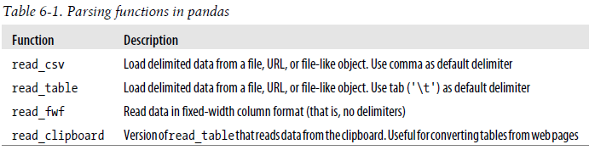
Text format
read_csv
read_table
Essentially the same. Use different delimiter by default, but can supply delimiter as a parameter.

Slide 34
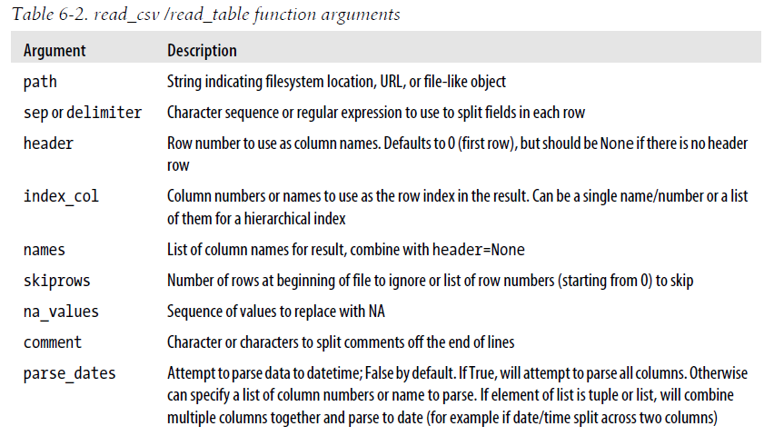

Slide 35
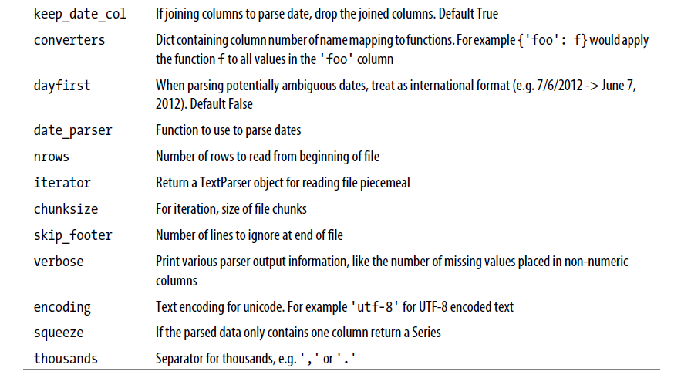

Slide 36
Writing data to text format
to_csv(path_to_file):
Other functions:
read_json()
read_html()
read_sql()

